Slide 1
What About Revelation 20?
December 5, 2021

Slide 3
Revelation 20:1-5
1 Then I saw an angel coming down from heaven, holding the key of the abyss and a great chain in his hand. 2 And he laid hold of the dragon, the serpent of old, who is the devil and Satan, and bound him for a thousand years; 3 and he threw him into the abyss, and shut it and sealed it over him, so that he would not deceive the nations any longer, until the thousand years were completed; after these things he must be released for a short time. 4 Then I saw thrones, and they sat on them, and judgment was given to them. And I saw the souls of those who had been beheaded because of their testimony of Jesus and because of the word of God, and those who had not worshiped the beast or his image, and had not received the mark on their forehead and on their hand; and they came to life and reigned with Christ for a thousand years. 5 The rest of the dead did not come to life until the thousand years were completed. This is the first resurrection.

Slide 4
Revelation 20:6-10
6 Blessed and holy is the one who has a part in the first resurrection; over these the second death has no power, but they will be priests of God and of Christ and will reign with Him for a thousand years. 7 When the thousand years are completed, Satan will be released from his prison, 8 and will come out to deceive the nations which are in the four corners of the earth, Gog and Magog, to gather them together for the war; the number of them is like the sand of the seashore. 9 And they came up on the broad plain of the earth and surrounded the camp of the saints and the beloved city, and fire came down from heaven and devoured them. 10 And the devil who deceived them was thrown into the lake of fire and brimstone, where the beast and the false prophet are also; and they will be tormented day and night forever and ever.

Slide 5
Revelation 20:11-15
11 Then I saw a great white throne and Him who sat upon it, from whose presence earth and heaven fled away, and no place was found for them. 12 And I saw the dead, the great and the small, standing before the throne, and books were opened; and another book was opened, which is the book of life; and the dead were judged from the things which were written in the books, according to their deeds. 13 And the sea gave up the dead which were in it, and death and Hades gave up the dead which were in them; and they were judged, every one of them according to their deeds. 14 Then death and Hades were thrown into the lake of fire. This is the second death, the lake of fire. 15 And if anyone's name was not found written in the book of life, he was thrown into the lake of fire.

Slide 6
Revelation 20 (one of John’s visions of what is to come)
This passage describes a thousand-year period of time when:
Satan will be bound in the abyss (vv. 1-3) and
Christ will reign upon the earth (vv. 4-6).

Slide 7
How Futuristic Premillennialism sees Revelation
Futuristic Premillennialism – sees Revelation 19-22 as occuring in the same order as presented. Therefore, the millennial kingdom of Revelation 20 is yet future. In this scenario we see:
The seven year period of tribulation (Rev. 6-19)
Jesus’ return in glory (Rev 19:11-16)
The resulting judgment upon the Beast and the False Prophet (Rev. 19:17-21)
The imprisonment of Satan in the abyss for a thousand years (Rev. 20:1-3)

Slide 8
How Futuristic Premillennialism sees Revelation
The millennial reign of Christ where Jesus will establish His kingdom on earth and will reign with the saints in perfect righteousness (Rev. 20:4-6)
Satan’s release after the thousand years and his permanent defeat (Rev. 20:7-10)
The resurrection and judgment of the wicked where they are thrown into the lake of fire (Rev. 20:11-15)
Finally, the eternal state of the new heaven and earth will begin.
This is the Futuristic Premillennial view of Revelation 20.

Slide 9
A key difference in millennial views:
The key difference is that Amillennialism, and Postmillennialism affirm that the thousand years of Revelation 20 is present, whereas Futuristic Premillennialsm maintains it is future.

Slide 10
What about Revelation 20?
We are going to examine several key features in Revelation 20 to demonstrate that it clearly teaches that the thousand year reign of Christ will take place after His second coming (Revelation 19). We are going to do this under the framework of four main questions:
The timing of Satan’s binding. Is it now or future?
The nature of the first resurrection. Is it physical or spiritual?
The duration of the thousand years. It is a literal or symbolic period of time? And,
The chronology of John’s visions. Sequential or a recapitulation?

Slide 11
The Timing of Satan’s Binding
In Revelation 20:1-3 John’s vision focuses on the status of Satan during the millennial reign of Christ.
¹ Then I saw an angel coming down from heaven, holding the key of the abyss and a great chain in his hand. ² And he laid hold of the dragon, the serpent of old, who is the devil and Satan, and bound him for a thousand years; ³ and he threw him into the abyss, and shut it and sealed it over him, so that he would not deceive the nations any longer, until the thousand years were completed; after these things he must be released for a short time.
Key question - Is Satan’s binding now or in the future?

Slide 12
The Timing of Satan’s Binding
Satan is bound, he is confined in the abyss, and it is shut and sealed over him.
The word “abyss” refers to a prison for evil spirits; when evil spirits are confined in the abyss, the Bible indicates that they are prevented from roaming free on the earth

Slide 13
Luke 8:31-32
31They were imploring Him not to command them to go away into the abyss. 32 Now there was a herd of many swine feeding there on the mountain; and the demons implored Him to permit them to enter the swine. And He gave them permission.

Slide 14
Revelation 9:1-3
¹ Then the fifth angel sounded, and I saw a star from heaven which had fallen to the earth; and the key of the bottomless pit was given to him. ² He opened the bottomless pit, and smoke went up out of the pit, like the smoke of a great furnace; and the sun and the air were darkened by the smoke of the pit. ³ Then out of the smoke came locusts upon the earth, and power was given them, as the scorpions of the earth have power.

Slide 15
The Timing of Satan’s Binding
Satan must first be “released from His prison” (vs. 7) before he can “come out to deceive the nations”
The NT describes Satan as “the god of this world” (2 Cor. 4:4), and “the ruler of this world” (John 12:31; 14:30; 16:11).
1 Peter 5:8 says the devil “prowls around like a roaring lion, seeking someone to devour.”

Slide 16
The Timing of Satan’s Binding
Activities of Satan:
He tells lies (John 8:44);
He tempts believers to sin (1 Cor. 7:5; Eph. 4:27);
He disguises himself as an angel of light (2 Cor. 11:13–15);
He seeks to deceive the children of God (2 Cor. 11:3);
He snatches the gospel from unbelieving hearts (Matt. 13:19; Mark 4:15; Luke 8:12 cf. 1 Thess. 3:5);
He takes advantage of believers (2 Cor. 2:11);
He influences people to lie (Acts 5:3);
He holds unbelievers under his power (Acts 26:18; Eph. 2:2; 1 John 5:19);
He “buffets” the servants of God (2 Cor. 12:7);

Slide 17
The Timing of Satan’s Binding
Activities of Satan:
He thwarts progress of ministry (1 Thess. 2:18);
He seeks to destroy the faith of believers (Luke 22:31);
He wages war against the church (Eph. 6:11-17);
He traps and deceives people, holding them captive to do his will (2 Tim 2:26).

Slide 18
The Nature of the First Resurrection
According to Futuristic Premillennialism, those individuals who “came to life and reigned with Christ for a thousand years” were part of “the first resurrection” of verse 5.
This is the first of two physical resurrections in Revelation 20, resurrections which are separated by one thousand years.
The first is a resurrection of the righteous – the faithful believers who are martyred during the tribulation (vs. 4) – and the second is a resurrection of the wicked who will stand before the throne of final judgment after the millennial kingdom (vv. 11-15)

Slide 19
The Nature of the First Resurrection
Is the “first resurrection” regeneration or conversion?
The word translated “resurrection” is used 41 other times in the N.T. and is never used to refer to regeneration.
The coming to life of “the rest of the dead” at the beginning of vs. 5.
The entire group of individuals who are raised in the first resurrection are resurrected together at the beginning of the millennium and then reign together with Christ for the entire one thousand years.
The individuals described in vs. 4 are not regenerated by the Holy Spirit until after they are martyred.

Slide 20
The Nature of the First Resurrection
Futuristic Premillennial View:
It is consistent with the use of the word resurrection, which refers to physical resurrection 41 out of 42 times in the N.T.
The word translated “they came to life” refers to the same kind of resurrection in vs. 5 as it does in vs. 4 – a physical resurrection.
It makes perfect sense of the terminology “first resurrection,” which obviously implies a second resurrection, the resurrection of the wicked one thousand years later.
It fits the context in which John sees those who were killed in the physical realm coming back to life in the physical realm.

Slide 21
The Nature of the First Resurrection
The most common argument against the Futuristic Premillennial view of two physical resurrections in Rev. 20 is that elsewhere the Bible teaches a single, general resurrection where the righteous and the wicked are raised at the same time.
Passages in question (Daniel 12:2; John 5:28-29; and Acts 24:15) do not actually preclude the possibility of two distinct resurrections separated by a period of time.
All three passages speak of a resurrection of the righteous and a resurrection of the wicked – and always in that order, the same as Rev. 20 - and they neither state nor require that the two resurrections happen at the same time.
Finally, remember that later revelation will sometimes clarify earlier revelation (progressive revelation).

Slide 22
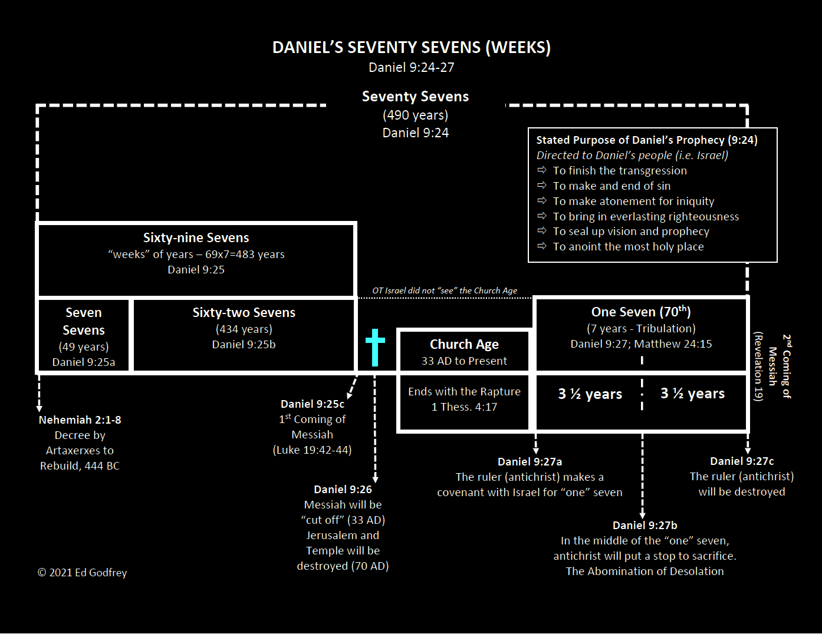
173,880 days

Slide 23
The Two Comings of Messiah
Luke 4:17-21
17 And the book of the prophet Isaiah was handed to Him. And He opened the book and found the place where it was written, 18 "THE SPIRIT OF THE LORD IS UPON ME, BECAUSE HE ANOINTED ME TO PREACH THE GOSPEL TO THE POOR. HE HAS SENT ME TO PROCLAIM RELEASE TO THE CAPTIVES, AND RECOVERY OF SIGHT TO THE BLIND, TO SET FREE THOSE WHO ARE OPPRESSED, 19 TO PROCLAIM THE FAVORABLE YEAR OF THE LORD." 20 And He closed the book, gave it back to the attendant and sat down; and the eyes of all in the synagogue were fixed on Him. 21 And He began to say to them, "Today this Scripture has been fulfilled in your hearing."
Isaiah 61:1-2
1 The Spirit of the Lord God is upon me, Because the Lord has anointed me To bring good news to the afflicted; He has sent me to bind up the brokenhearted, To proclaim liberty to captives And freedom to prisoners; 2 To proclaim the favorable year of the Lord And the day of vengeance of our God…

Slide 24
Two Comings – Two Resurrections
There was no clear evidence in the O.T. alone that there would be two separate comings of Messiah separated by a significant period of time.
In the same way here, when it comes to the future resurrection, what the earlier writers of Scripture seemed to depict as a single resurrection we now see as involving two resurrections. A resurrection of the righteous and then a resurrection of the wicked one thousand years later.

Slide 25
What About Revelation 20?
What About Revelation 20?
December 5, 2021

